Slide 1

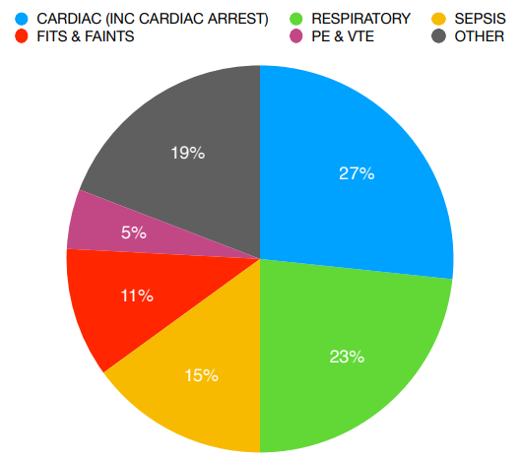
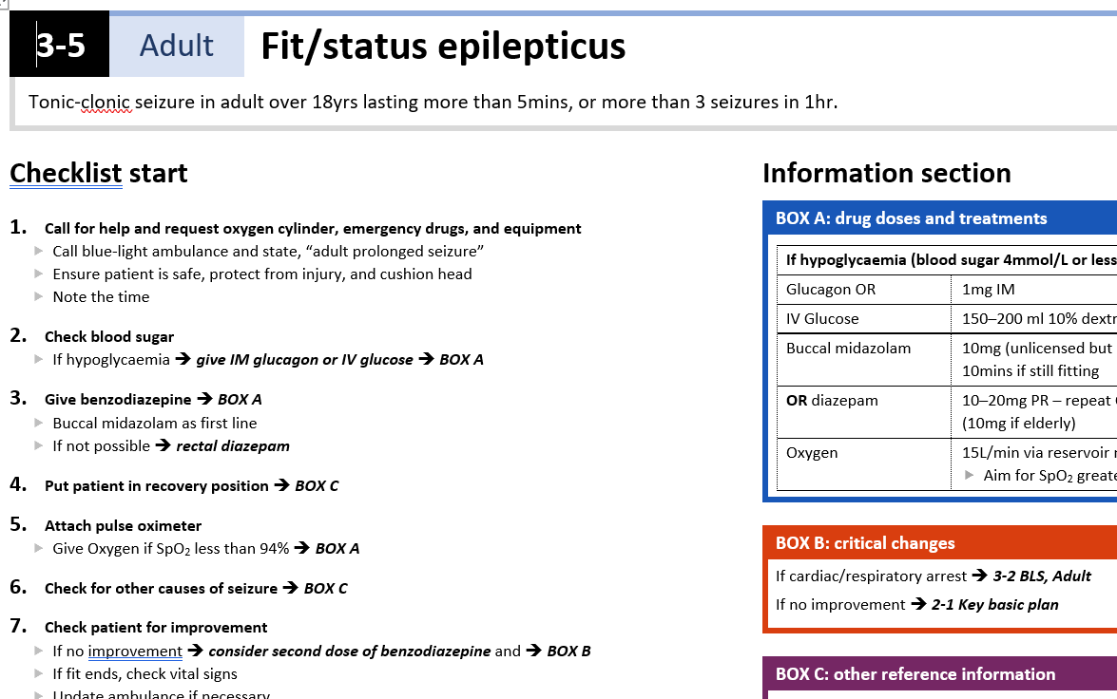
MAGIC
The Management of Acute emergencies in GP surgeries using In situ simulation and Checklists
Background
A survey of 88 clinical staff from 22 practices showed:
encountered at least one emergency in the
97% GPs had last 12 months
Ambulance delays occurred of up to 4 hours in 50%
76% of GPs had no emergency training in the last 12 months (excluding BLS)
300 Emergencies occurred in 13 broad themes
The top five themes were Respiratory; Cardiac; Sepsis; Neurological; Anaphylaxis
Less than 1% involved a cardiac arrest
Your Experience
How often do you have emergencies in your surgery?
Who leads these when they happen?
How confident do you feel now to deal with a medical emergency in your surgery?
Checklists reduce errors, provide support structure & team performance is improved
RISKS TO PATIENT SAFETY
NO NATIONALLY AGREED TRAINING PROGRAM
HIGH RISK
LIFE THREATENING
LOW FREQUENCY LACK PRACTICE
STAFF WITH NO EMERGENCY TRAINING
UNFAMILIARITY WITH DRUGS AND EQUIPMENT
LACK OF CONFIDENCE AND ANXIETY
AMBULANCE DELAYS
LITTLE PRIMARY CARE GUIDANCE
The GP Quick Reference Handbook
Developed with GPs for GP teams
Handbook of checklists for emergency situations
15 clinical checklists (8 adult, 7 paediatric) 1 non-clinical checklist Standardised presentation of materials Supports but does not replace professional judgement
Why Choose Us
Checklists reduce errors, provide support structure & team performance is improved
In-situ simulation is a safe, supportive environment to practice and build confidence in the environment it may be needed
Paramedics are trained regularly using simulation techniques and utilising checklists, so can promote confidence in this type of training
We will train your Paramedics in to be trainers for your practices and oversee future developments
Our Vision
Training for Primary Care settings, free for all; resulting in staff confidence, resilience and improved patient outcomes in emergency situations
For further information
primarycare@collegeofparamedics.co.uk
emily.styles@collegeofparamedics.co.uk

