Slide 1
Symptom control using subcutaneous medications at End of Life
Community Specialist Palliative Care Team

Slide 2
Learning objectives
Having completed the session, you will be able to:
Discuss symptoms that commonly arise in the last days to hours of life
Identify reversible symptoms and appropriate management of them
Recognise your competency and the importance of MDT decision making
Understand the different prescribing principles of subcutaneous PRN medications 24 hours syringe driver medications and opioid conversion
Know where to access local guidelines for subcutaneous prescribing at EOL and be able to convert oral opiates to appropriate subcutaneous doses
Understand how to use the Subcutaneous Medication Sheet
Understand the advantages and disadvantages of prescribing PRN subcutaneous medication in anticipation of symptoms often experienced at EOL
Notes:
?add bullet re opioid conversion?

Slide 3
Why has this education session been developed?
A previous audit identified in Cornwall there was:
a lack of recognition of the difference between subcutaneous PRN and syringe driver medications.
Syringe drivers were being prescribed many months prior to need.
A lack of evidence that consideration was given to reversible causes of deterioration.
Within the CFT EOL Policy, it states;
'CFT does not routinely advocate for the use of anticipatory syringe driver prescribing, as the person at the end of their life will require a personalised review and assessment by the prescriber at the time of the syringe driver being commenced.'

Slide 4

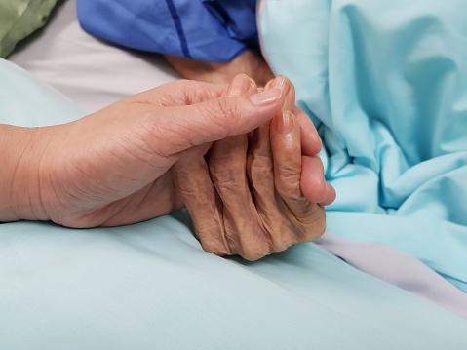
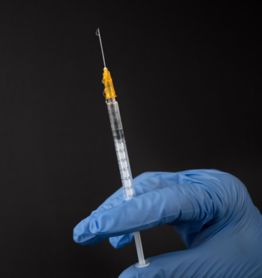
Providing symptom control using subcutaneous medications at end of life

Slide 5
What symptoms are commonly experienced by dying people?
Pain
Breathlessness
Nausea and vomiting
Restlessness and agitation
Respiratory secretions
Notes:
Ask the group

Slide 6

Stages of symptom management
Assessment (holistic) / history taking
Reverse the reversible
Non ‘medical’ (non-pharmacological) treatment
‘Medical’ (pharmacological) treatment
Get advice
Monitor / review
Twycross, Wilcock and Stark Toller (2009)
Notes:
Useful mantra to remember with symptom management
Ask what a holistic assessment includes?
A holistic assessment is required and includes:
Background information about the person’s life
Personal strengths, aspirations and priorities
Religious or other belief, cultural and lifestyle factors
Current physical health and prognosis, including underlying health or other conditions
Social, occupational, psychological and emotional and spiritual well-being
Religion and/or spiritual well-being, where appropriate
Risk and risk management

Slide 7
It's important to think about patient factors when treating symptoms in a dying patient
How am I going to assess the impact of the symptom on the patient?
Are any symptoms preventable?
How often do I need to assess for symptoms?
Does the patient have any comorbidities such as Parkinson's disease, renal impairment or heart failure?
What medication is the patient already taking?
Do we need to change the route of administration of the medication?
Notes:
How am I going to assess the impact of the symptom on the patient?
Often patients in the last few days of life are increasingly drowsy and communication can be difficult. It is important to look out for non verbal signs of pain and distress, take Into account carers' thoughts and the views of other professionals looking after the patient.
Are any symptoms preventable?
Many symptoms are preventable by provision of excellent supportive care. For example, supporting the patient to take drinks for as long as they are able to will reduce thirst; the use of an alternating pressure mattress will reduce pain by minimising pressure and avoiding skin breakdown; and good bladder and bowel care will reduce agitation secondary to urinary retention and constipation.
How often do I need to assess for symptoms?
Symptoms in dying patients can change rapidly and a plan to 'review tomorrow' may not deliver effective care. Patients should be reviewed every time a new symptom develops and again soon after to assess the impact of any intervention.
Does the patient have any comorbidities such as Parkinson's disease, renal impairment or heart failure?
This influences the choice of drug that can be used to help control their symptoms. It will also be important to consider which drugs may need to be continued to avoid deterioration in symptoms. For example, continuing diuretics in heart failure. This is a prescribing decision and should discuss this with their GP/Dr
What medication is the patient already taking?
Are these to help control their symptoms or are they no longer of benefit and could be stopped? Alert GP/prescriber
Do I need to change the route of administration of the medication?
Assume that the oral route will not always be possible, if not immediately, then in the near future and discuss with the prescriber regarding medication for symptom management by alternative routes ie sublingual, subcutaneous (SC) PRN doses in anticipation of this.

Slide 8
It's important to think about treatment factors when treating symptoms in a dying patient.
Is the cause of the symptom reversible without medications?
Is the cause of the symptom reversible with specific medication?
Which medication can be given to ease the symptom regardless of cause?
What side effects do these medications have? Are these side effects acceptable to the patient?
Notes:
Is the cause of the symptom reversible without medications?
E.g. repositioning to help respiratory secretions, the use of a catheter to reduce agitation secondary to urinary retention.
Is the cause of the symptom reversible with specific medication?
E.g. the use of furosemide to treat pulmonary oedema or the use of suppositories to help faecal impaction.
Which medication can be given to ease the symptom regardless of cause?
As well as considering which medication to give it is vital to plan who is going to give the medication, how the medication can be accessed and given in a timely fashion, and the best way (route) of giving that medication if the patient can't swallow. For many patients accessing the medications in a timely way can be challenging and requires clear planning.
What side effects do these medications have? Are these side effects acceptable to the patient?
It is always important to consider the balance of benefits and burdens of treatment and to discuss side effects, particularly sedation, with patients and those caring for them.

Slide 9
What are some common reversible causes resulting in symptoms, that may be experienced in the last days of life?
Urinary retention
Constipation
Poor positioning (can impact comfort, respiratory secretions, and pressure areas)
Dry mouth
Anxiety/fear
Issue with medication (i.e. opiate toxicity)

Slide 10
Managing breathlessness case study
Joy is a community nurse and has been called by Jack O'Malley who is anxious about his partner, Patrick Brown.
Mr Brown has severe COPD and is now dying. He wants to remain at home, but his breathing is really frightening him.
As a nurse in Joy’s situation what would be your thoughts and what would you do?

Slide 11
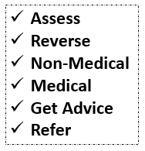
Nurse considerations:
Is there any reversible aspect to the breathlessness?
Has he got an infection?
Does he need to go into hospital?
How can I help his breathlessness?
Can I do something non-medical/nonpharmacological to help?
Which medication can I give to help the feeling of breathlessness?
I hope there is some medication in the house I can give him.
Do I need to call the prescriber if medication isn't in the home?

Slide 12
Joy assesses Mr Brown at home. He is slumped in bed, and clearly very breathless. He is fatigued and struggling to eat and drink. He tells Joy that he wants to die at home but is frightened. Mr O'Malley is keen to support his partner's wish but does not know what to do to help his breathing.
What should Joy do?

Slide 13
Joy’s actions
Assist Mr Brown to sit up – as it can make the work of breathing easier.
Place a fan near Mr Brown - the movement of air across the face can help the feeling of breathlessness. (However, note that a fan should be avoided in viruses such as Covid-19 due to the aerosol effect).
Open a window - the movement of air across the face can help the feeling of breathlessness.
Consider his COPD management - he may have steroids and a nebuliser but may have stopped taking them. If he has not tried such treatment during this deterioration and it is thought that they are likely to be helpful, they should be considered and discussed with him. If it is thought that they will not help they should not be commenced. This may require discussion or assessment from his GP.
Establish if anticipatory medication are available in the house - medications such as morphine and midazolam are useful in this situation - she discovers that there are no medications for terminal breathlessness in the house.
She calls the GP, Dr Goodyear, who visits.

Slide 14
Dr Goodyear’s thoughts:
This gentleman is clearly dying- reversible causes excluded
His breathing is really bothering him.
He needs some medication to help this.
What medication should I prescribe, what dose and how should it be given?
Surely we could have anticipated this would happen?
Shouldn't we have this medication in the house already?

Slide 15
Potential advantages & disadvantages of having just in case (PRN) medications readily available
ADVANTAGES
Enables prompt symptom relief, regardless of day of the week or time of day
Encourages conversations about goal of treatments, prognosis, and how to access appropriate care as the patient deteriorates
Potentially reduces hospital admissions
Reduces out of hour GP visits
Makes it more likely that a patient will die at home if they want to
Provides reassurance to some patients & carers.
DISADVANTAGES
The drugs may remain in the community for extended periods of time
The drugs may not be used
The drugs potentially might not be used by the patient, but by others for recreational purposes
The availability of such medication may encourage their administration without proper assessment, for example, midazolam might be given for terminal agitation when a proper assessment would have revealed a distended bladder and the need for a catheter as the cause of the patient’s distress
May be distressing for some patients & families ‘a reminder of death’ (emerging evidence)

Slide 16
What should Dr Goodyear do?
Prescribe and authorise morphine 2.5 mg SC 1 hourly PRN
Prescribe and authorise midazolam 2.5 mg SC up to 1 hourly PRN
Prescribe and authorise morphine 10mg SC 1 hourly PRN
Prescribe nebulised salbutamol 2.5mg 2 hourly
E. Send Mr Brown to hospital
Notes:
A. Correct. Morphine is used for the relief of the sensation of breathlessness.
B. Correct. Midazolam is useful for the anxiety associated with breathlessness.
C. Incorrect. This dose is harmful in an opioid naïve patient.
D. Incorrect. If it is already determined that Mr Brown does not want any more active treatment, then this would be inappropriate.
E. Incorrect. Mr Brown wants to stay at home.

Slide 17
What happens…
Dr Goodyear writes a prescription and authorisation for morphine 2.5 mg SC 1 hourly for breathlessness and midazolam 2.5mg SC up to 1 hourly PRN for breathlessness.
Mr O'Malley calls his friend to collect the prescription and take it to the chemist. He arrives back with the medication 2 hours later, by which time Mr Brown is very breathless again.
Joy gives 2.5mg of morphine SC which really helps Mr Brown to feel less breathless.
Mr O'Malley needs to call the OOH service back during the night as Mr Brown becomes breathless again. They give him another dose of morphine 2.5mg which is effective at easing his breathlessness. Mr Brown dies the following day.
Notes:
Potentially ask what thoughts people have before moving to the next slide – so viewers can still see this slide.

Slide 18
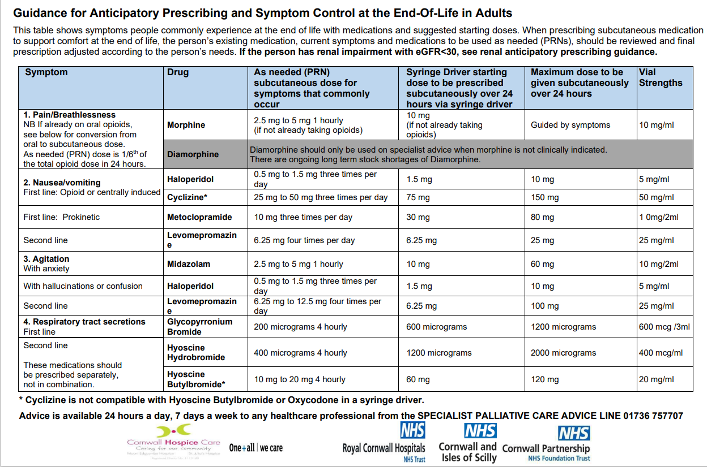
Anticipatory Prescribing guidance

Slide 19

What are your thoughts on this management?
Where should you go for further guidance regarding subcutaneous prescribing at EOL?
Notes:
Thorough assessment is essential
You may be in the house on your own but if you are not sure phone for advice
PRN medications were sufficient to manage symptoms in this case, a syringe driver is not always needed

Slide 20
Using Opioid dose conversion chart to consider:
If Mr Brown was already taking slow release morphine 30mgs twice a day would this have changed the management of his symptom control?
How would we calculate starting dose for syringe driver and PRN dose?
Notes:
Look at opioid chart on next slide and talk through

Slide 21
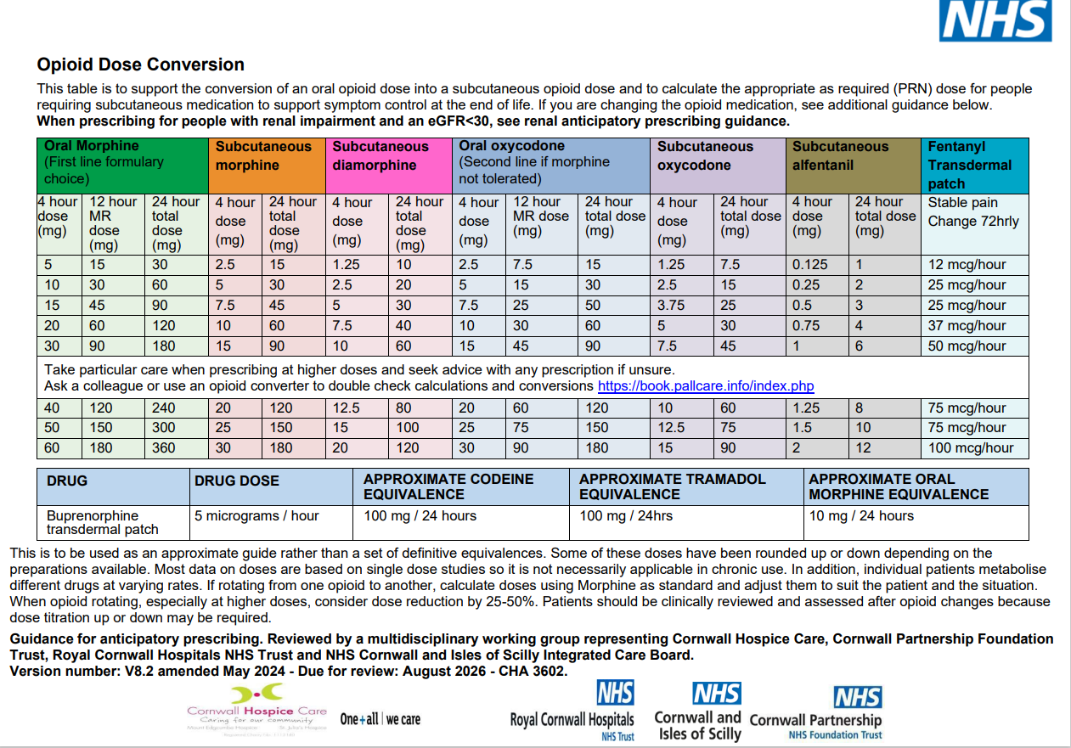
Notes:
Look at converting between opiates and working out doses if on slow release opiate and prn doses
- 30mgs BD = 60mgs 24 hour total dose – indicating syringe driver starting dose 30mgs and prn dose of 5mgs

Slide 22
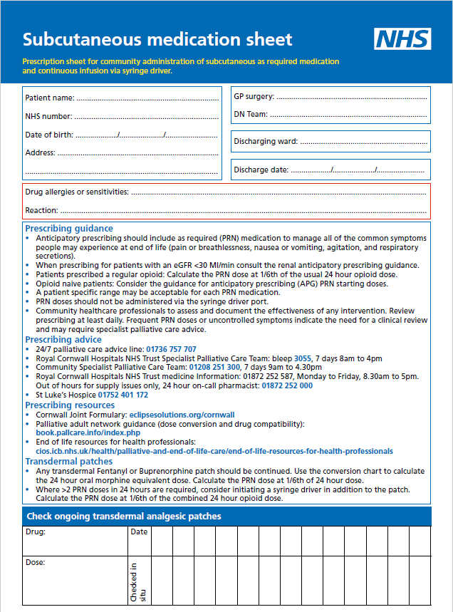
Page 1 summary Prescribing guidance including:
Prompts for renal prescribing.
For opioid naïve patient consider Guidance for anticipatory prescribing starting doses.
PRN usually 1/6th of 24 hour opiate dose.
Advises a patient specific range may be acceptable for PRN medication.
Alerts not to administer PRN medication via the syringe driver port.
Assess and document effectiveness of any intervention, review prescribing daily. Frequent PRN dose or uncontrolled symptoms indicate the need for clinical review and may require specialist advice.
A check that transdermal analgesic patch is in situ so you can take this into account when calculating PRN opiates. Usual transdermal analgesic patches continue with a syringe driver. Ensure patient/ family know to continue patch medication. This is not a prescription for a transdermal patch. Continuation sheet available.
Notes:
Page 1 content:
Patient information
Prescribing guidance.
Phone numbers and websites for advice
Transdermal patches – errors and poor decisions have been made regarding symptom control related to transdermal patches ie there has been no check that transdermal patches are continuing, the family don’t realise they are to continue and stop them, the patient has increased pain and stopping of transdermal patches has not been picked up as a cause of increased pain or the transdermal patch has fallen off. Remember that transdermal opioid patches are not used to calculate the syringe driver starting dose.
Medication sheet continuation sheet - CHA4918
Transdermal Patch Check continuation sheet – CHA4921

Slide 23
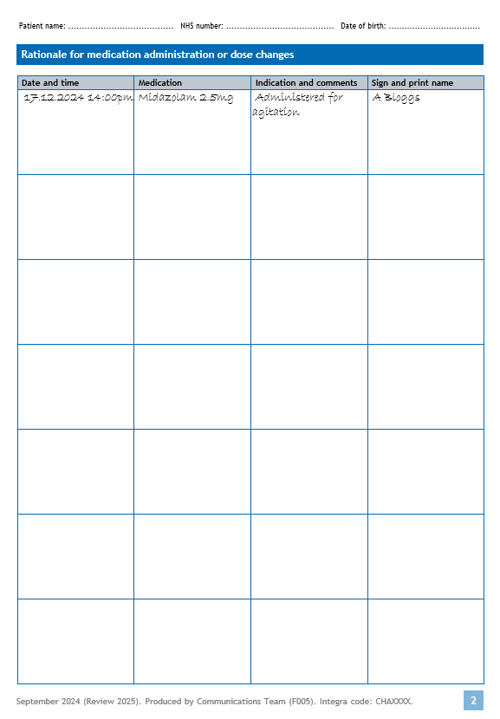
Record reason for medication changes, a rationale is very important. The effectiveness of a medication should also be recorded here.
PRN (as required) medications dose & drugs are recorded here.
Additional key communication can be recorded in the indication/comments column.
Continuation sheets are available
Notes:
Presentation – we know that patients and families often have concerns about medications, their benefits and their side effects, yet in the audits to date we know this is not always recorded. This section is designed to enable recording of benefits or burdens of medications given PRN to inform syringe driver changes.
CHA4922

Slide 24
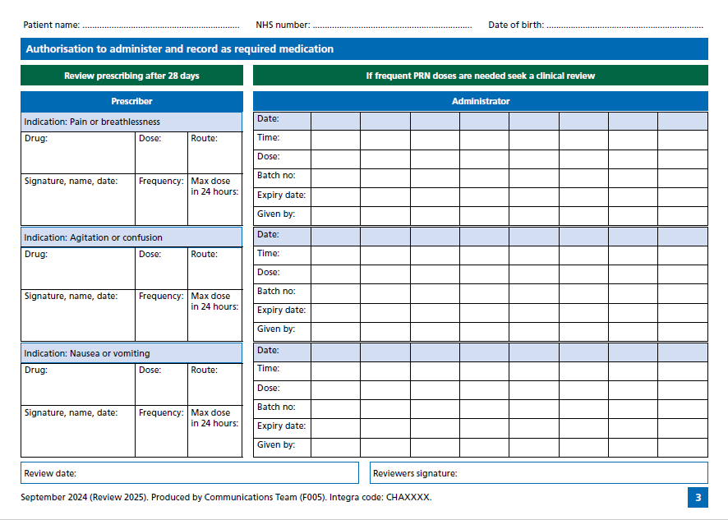
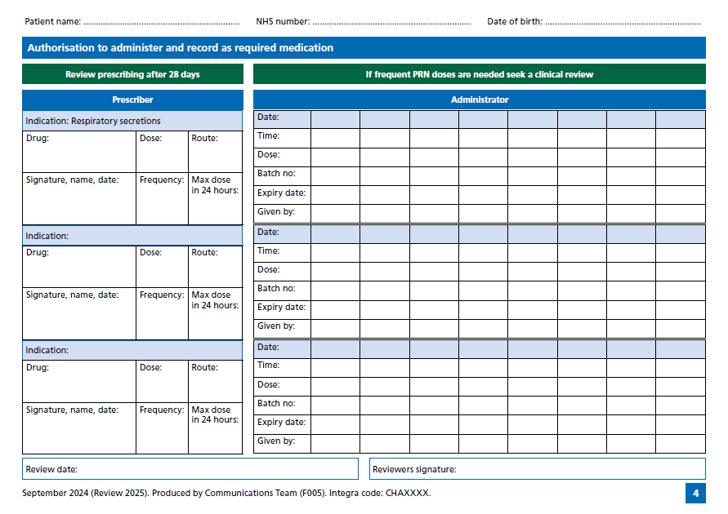
Pages 3 and 4 are for prescribing and recording administration of PRN (as required) medications with symptom indication prompts – breathlessness, agitation/confusion, nausea/vomiting, respiratory secretions and some blank indications if required.
Notes:
Blank pale blue headings can be used to prescribe more of specific medication.
The prescribing section is on the left side of the page and administration section on the right.

Slide 25
Guidance to support symptom control and anticipatory prescribing in Cornwall
“Rapid reference guide to subcutaneous prescribing in the last days of life”, countywide prescribing principles https://www.cornwallft.nhs.uk/policies-and-procedures?media_item=20873&media_type=10#file-viewer
Accompanied by supporting organisation specific guidance “Palliative and End of Life subcutaneous medication clinical guideline” https://www.cornwallft.nhs.uk/policies-and-procedures?media_item=20915&media_type=10#file-viewer
This combines:
Subcutaneous prescribing principles
Saf T Initima guidance for PRN dose administration
Via the ICB website https://doclibrary-rcht.cornwall.nhs.uk/DocumentsLibrary/RoyalCornwallHospitalsTrust/Clinical/PalliativeAndEndOfLifeCare/GuidanceForAnticipatoryPrescribingAndSymptomControlAtTheEndOfLife.pdf
Guidance for Anticipatory Prescribing and Symptom control at the end of life’ (APG V8.2) CHA3602 and Cornwall and IOS Renal anticipatory prescribing guidance for symptom control in opioid naïve patients with renal impairment eGFR<30’ CHA4472 is available.

Slide 26
Key messages from subcutaneous guidelines
Advocates PRN subcutaneous medication (as required) for symptom relief, pre-emptively prescribed according to a person's individual needs
For best practice a syringe driver should only be prescribed following a clinical review with consideration given to reversible causes of deterioration, associated symptoms, and evaluation of PRN medications.
For symptom control initially titrate with PRN subcutaneous medication, this helps inform any syringe driver
A small patient specific range may be acceptable for PRN medication ie morphine 2.5 – 5 mg

Slide 27
Key messages continued
Where a small range is available, initially the smallest dose should be administered with titration up as required for the individual patient
For patient on a long-acting opiate the PRN dose is generally one sixth (1/6th ) of the usual 24-hour opiate dose
If two or more PRN doses are required in 24 hours, and symptoms persist, consider commencing a syringe driver

Slide 28
Key messages – Saf T Intima
PRN doses can be administered via a straight Saf T Intima, but not the Saf T Intima attached to the syringe driver
different medications are not to be mixed in the same syringe for PRN administration, a flush is required between medications
The Saf-T-Intima straight device only should be used. It does not need to be primed

Slide 29
Key messages - Saf T Intima
The flush volume is 0.35mls of NaCl 0.9% to be drawn up in a 1ml, 2ml or 3ml luer lock syringe for accuracy (do not use Irripods)
If the patient requires 2 drugs, you would administer Drug 1 → 0.35mL flush → Drug 2 → 0.35mL flush.
You can administer 2mL per site via the Saf-T-Intima
There is a NaCl 0.9% PGD (patient group directive) which can be utilised for the purposes of flushes (Document reference code: MM/079/22) Do not use water for flushing the Saf-T-Intima device.
Any nurses using the PGD has to be trained and up to date with the Trusts PGD training, including eLearning and PGD assessment.

Slide 30
Key messages - commencing a syringe driver
The starting dose should be specific to the lowest dose required to achieve symptom relief.
It may be appropriate to have a set incremental increase, with maximum dose
A syringe driver takes 4 – 6 hours to take effect. Patients with existing symptoms will require a concurrent PRN dose
If a syringe driver has been prescribed in anticipation of imminent, rapid deterioration, where they syringe driver has not commenced the prescribing decision should be reviewed no later than 7 to 10 days after the initial prescription
Ensure the role of syringe driver administration is explained to the patient and family, including possible side effects from medication

Slide 31
Key messages – commencing a syringe driver
Ensure patient/ family know what oral medications, if any, are to continue.
Any existing Fentanyl or Buprenorphine patch should generally be continued. Change the transdermal patch at the prescribed interval
Ensure the family know who to contact should there be a problem with the syringe driver or symptoms are no longer controlled.

Slide 32
If you are not sure, check before acting…
NMC code of conduct (2015) - The professional commitment to work within one’s competence is a key underpinning principle of the Code. Section 13.3 ask for help from a suitably qualified and experienced professional to carry out any action or procedure that is beyond the limits of your competence
Palliative Care Advice Line 01736 757707
Community Specialist Palliative Care Team 01208 251300
Medicines Information 01872 252587
Syringe driver Compatibility https://book.pallcare.info/

Slide 33
Don’t forget…
Document your assessment, including the effectiveness of any previous medication
Record your decision making and rationale
Talk with the wider MDT to share the responsibility
Incident report any prescribing errors
Look after yourself☺

Slide 34
Discussion points from clinical scenario from RIO
Look back at the notes you wrote at the start of the session when we looked at the Rio entry.
Have you any questions about it that are not covered in the presentation

Slide 35

If you want to learn more about end of life

Slide 36

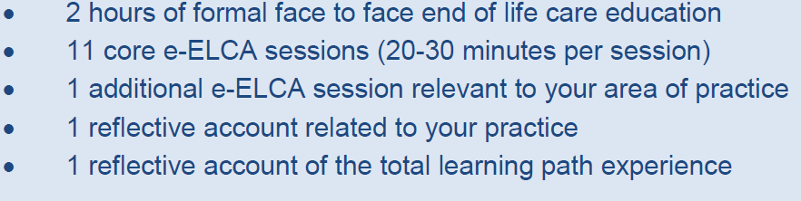
You should aim to complete your Learning Path within 6-12 months. You can then contact the learning path link/s for your organisation who will review the evidence in your Learning passport. You will then be awarded your ‘Inspiring End of life education’ badge in recognition of all your hard work.

Slide 37
References
Association of Supportive and Palliative Care Pharmacy’s (2020) Anticipatory prescribing of medicines for syringe pumps – ASPCP policy statement, Available at:https://www.aspcp.uk/anticipatory-prescribing-of-medicines-for-syringe-pumps-aspcp-policy-statement/ Accessed 01.09.22
Bowers, Pollock and Barclay (2021) Unwelcome memento mori or best clinical practice? Community end of life anticipatory medication prescribing practice: A mixed methods observational study, Palliative Medicine Journal, 36: 1, p95-104, Accessed at: https://journals.sagepub.com/doi/10.1177/02692163211043382
Symptom management for the dying adult: respiratory symptoms, diabetes control and anticipatory prescribing https://portal.e-lfh.org.uk/ accessed 11.10.2022
The Code – Nursing and Midwifery Council (2015) https://www.nmc.org.uk/standards/code accessed 11.10.2022
Gosport Independent Panel Report (2018) https://www.gosportpanel.independent.gov.uk/panel-report/
Twycross, Wilcock and Stark Toller (2009) Symptom Management in Advance Cancer, 4th edition

