Slide 1
End of Life and dementia
Paul Cadger – Dementia Education Lead

Slide 2
Objectives
Understand dementia is a palliative illness
Recognising end of life in dementia
Challenges for dementia and end of life
Supporting loved ones and carers
Supporting someone with dementia with recent and historic bereavement

Slide 3
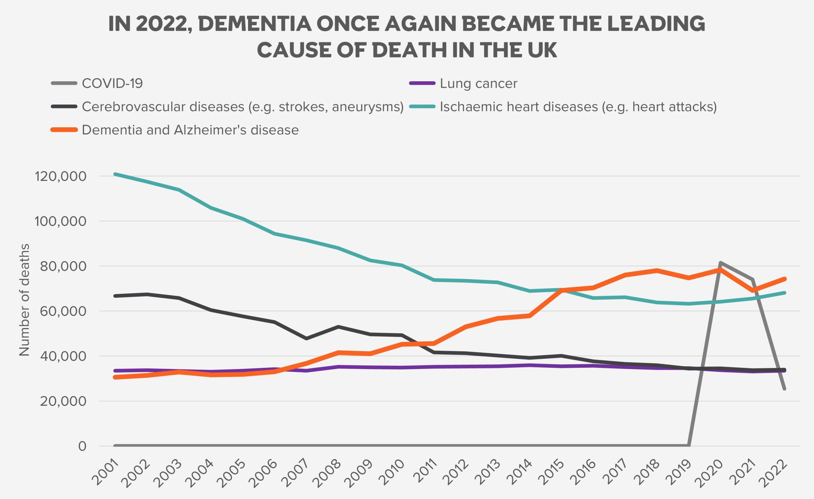
Quick statistics end of life and dementia
Dementia is leading cause of death in UK (11.3%)
Of top 10 causes of death only one without a cure
Nearly 2x the number of women died of dementia than men in ’22 (42,000 / 24,000)
Since 2011 dementia leading cause of death for women, for men it remains heart disease

Slide 4
Why is dementia palliative and a cause of death?
What is the difference between palliative and end of life care?
All forms of dementia are progressive disease of the brain
An indirect link between dementia and actual cause of death
Aspirational pneumonia 30% of dementia related deaths
Malnutrition and dehydration
Recurrent infections
Falls
Cause of death subarachnoid haemorrhage ➔ Why
Fall ➔ Why
Reduced reflexes, malnutrition, dehydration, weak immune system, recurrent infections, deconditioned, delirium, etc…. ➔ Why
Dementia
When would the “dying/terminal phase” commence?

Slide 5
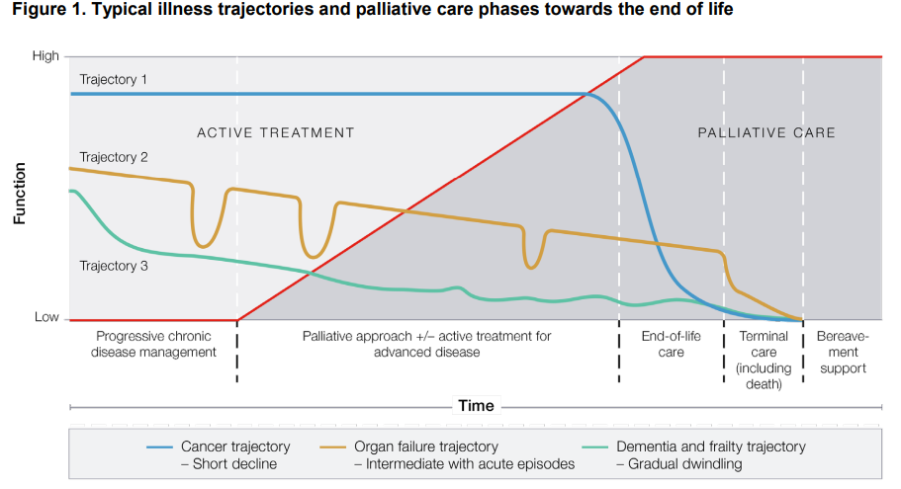
Recognising end of life in dementia?
The Royal Australian College of General Practitioners, 2022
Notes:
Usually 6-8 years of gradual decline

Slide 6
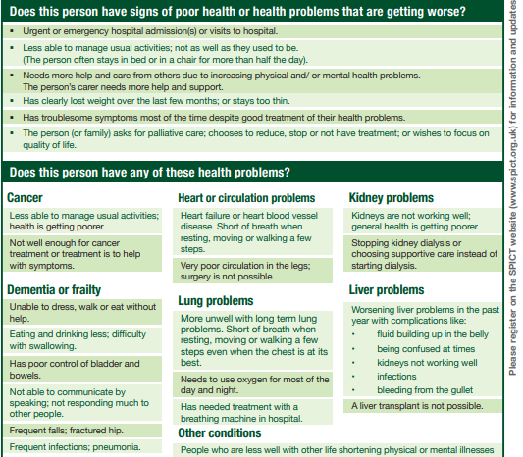
Recognising end of life in dementia?
Supportive and Palliative Care Indicators Tool
(SPICT-4ALL™) 2025

Slide 7
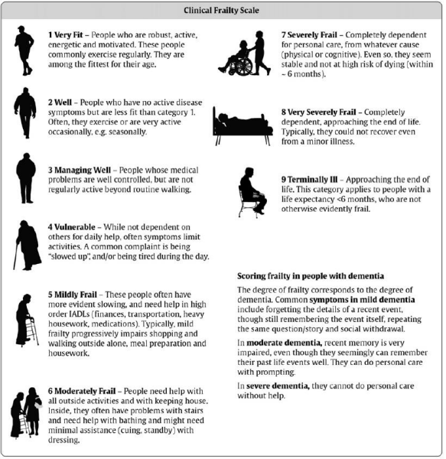
Recognising end of life in dementia?
Clinical Frailty Scale, 2012

Slide 8
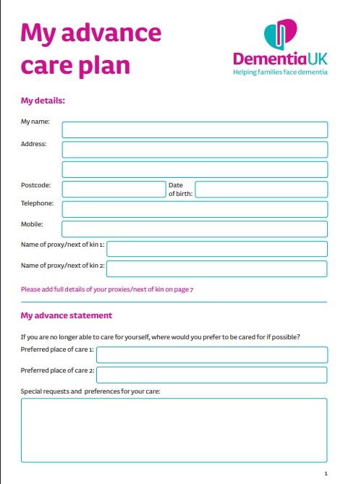
Challenges for dementia and end of life – planning ahead / capacity
Person may undergo multiple losses; personhood, personality, autonomy, mental capacity
Advance Care Planning includes LPoA, Advance decisions to refuse treatment & TEP
http://doclibrary-rcht-intranet.cornwall.nhs.uk/DocumentsLibrary/RoyalCornwallHospitalsTrust/Forms/FormsToPrint/Accessible/Specialty/PalliativeAndEndOfLifeCare/CHA4308MyAdvanceCarePlan.pdf
https://www.dementiauk.org/wp-content/uploads/dementia-uk-template-advanced-care-plan.pdf

Slide 9
Challenges for dementia and end of life – planning ahead / capacity - Scenario
Jim 81 living at his daughter’s house with her young family
Jim has vascular dementia, frail and has recurrent falls,
He has a 3 times daily care package and managing well
Jim has a lasting power of attorney for finance, funeral plan and Treatment Escalation Plan.

Slide 10
Challenges for dementia and end of life – planning ahead / capacity – Benefits of ACP
Benefits of Advance Care Planning for People with Dementia
Preserves Autonomy
Ensures the person’s values and preferences guide future care, even if they can’t express them later.
Reduces Family Stress
Loved ones won’t have to guess or make difficult decisions in a crisis.
Improves Quality of Care
Aligns medical interventions with the person’s goals and comfort.
Promotes Dignity
Respects the individual’s wishes about life-sustaining treatments, living arrangements, and end-of-life care.
Encourages Open Communication
Strengthens trust and understanding between the person, their family, and healthcare providers.

Slide 11
Challenges for dementia and end of life – planning ahead / capacity – How to approach
Ways to Discuss ACP with Someone Living with Dementia
1. Choose the Right Time and Setting (quiet, familiar, fatigue)
2. Use Simple, Reassuring Language
“Let’s talk about what matters most to you as we plan for the future.”
3. Break It Into Small Conversations
Start with values: “What makes a good day for you?”
Then move to preferences: “If you were very sick, what would you want us to know?”
4. Involve Trusted People
Include family members or friends the person trusts.
5. Use Visual Aids or Written Prompts
Tools like “My Wishes” or “Five Wishes” documents can help guide the conversation.
6. Revisit the Conversation Over Time
Dementia is progressive, so revisit and update the plan as needed.
WHAT MATTERS TO ME 4K_click CC for subtitles on Vimeo

Slide 12
Challenges for dementia and end of life – Early identification = better management
Anticipatory medications – prescribed at end of life (just in case scenario)
Pain
Anxiety
Delirium / agitation
Nausea and vomiting
Breathlessness
Secretion
Seizures
Haemorrhage
To ensure comfort and wellbeing are maximised
Co-morbidities rather than dementia

Slide 13
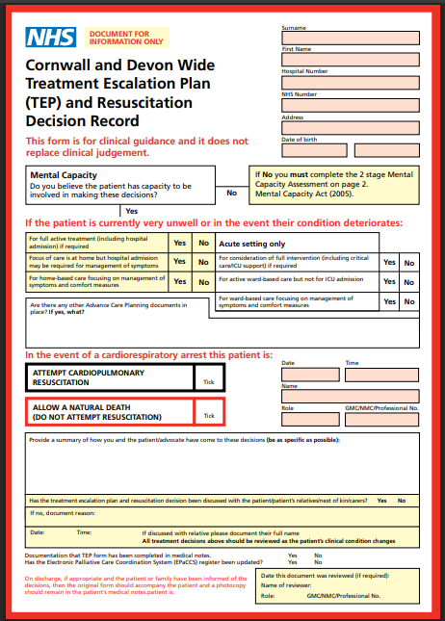
Challenges for dementia and end of life – Interventions
Education of family and carers
TEP form (accessible and reviewed regularly)
When to stop antibiotics, blood tests, intravenous meds
When to stop recording vital signs (sleep-wake cycle)
Preferred place of death, transport if in hospital
Eating, drinking and swallowing

Slide 14
Challenges for dementia and end of life – pain
Barriers to managing pain well
Unable to communicate feelings
Can’t remember what pain is
Unable to identify where pain is located
Error in thinking behaviours indicating pain are “symptoms of the person’s dementia
#NOF receive 1/3 analgesia
RCHT NAD 2020 – non-verbal patient still asked to score pain 0-10
Pain assessment tools
RCHT – PAINAD (PAIN in Advanced Dementia)
CFT – Abbey pain scale
Pain Assessment in Impaired Cognition Scale (PAIC)
Checklist of Nonverbal Pain Indicators (CNPI)
Assess pre/post

Slide 15
Challenges for dementia and end of life – Connection
Senses - Namaste care – touch, taste, smell, sight
Reminiscing
Music
May not know your name, but will know you are a person helping to make them feel safe and loved”

Slide 16
Challenges for dementia and end of life – delirium vs terminal restlessness
Terminal restlessness is a form of delirium. However, not reversible as associated with dying itself (last few days/hours).
Investigate any underlying cause (PINCHME) more proactive with sedative and antipsychotics than delirium – still evaluate treatment plan.
Supportive care for family, understand medication to reduce distress not hasten death
D
Describe
87 ♂vasc dementia, stopped eating 1 week ago, past 24hrs fidgeting, shouting for help, scared
Investigate
PINCHME, this is me
Create
Adapt environment – namaste
Support Family
Delirium care plan
Evaluate 1
No resolution add medication to reduce distress (low and slow)
Evaluate 2
Titrate – breathing slows, agitation reduces, no longer shouting or scared
I
C
E

Slide 17
Supporting loved ones and carers
Individualised care – what matters to the person dying
Involve those closest to the person
Optimise symptom management
Mouthcare
Comfort feeding
Support identifying funeral arrangements if not pre-arranged
Explain what to expect when their loved one reaches the end of life – prepare them
Identify cultural, spiritual and religious needs
Bereavement Support with Cornwall Hospice Care

Slide 18
Supporting a person living with dementia through grief
Long ago grief
Recent grief
“Where is my mum??”
“I want to see my husband?”
https://www.mentalhealth.org.uk/sites/default/files/2022-09/MHF-dementia-truth-inquiry-report.pdf
Consistency
Validation principle
Distraction
Entitled to grieve
Timeliness
Therapeutic lie
Notes:
e, untruths can be seen as strategic therapeutic interventions. Their use is sometimes compared to use of psychotropic drugs in this area; for example, they should be employed with caution and only in situations where other approaches have been trialled first

Slide 19
References
Alzheimer’s research UK (2025) Deaths due to dementia available at https://dementiastatistics.org/about-dementia/deaths/ Accessed on 17/04/2025
Dementia UK (2025) My advance care plan available at https://www.dementiauk.org/wp-content/uploads/dementia-uk-template-advanced-care-plan.pdf accessed on 29/05/2025
Mental Health Foundation (2016) What is truth? An inquiry about truth and lying in dementia care. Available at https://www.mentalhealth.org.uk/sites/default/files/2022-09/MHF-dementia-truth-inquiry-report.pdf accessed on 29/05/2025
Moorhouse P, Rockwood K. Frailty and its quantitative clinical evaluation R Coll Physicians Edinb. 2012;42:333-340. Available at https://www.england.nhs.uk/south/wp-content/uploads/sites/6/2022/02/rockwood-frailty-scale_.pdf Accessed on 17/04/2025
Royal Cornwall Hospitals NHS Trust (2023) My advance care plan available at http://doclibrary-rcht-intranet.cornwall.nhs.uk/DocumentsLibrary/RoyalCornwallHospitalsTrust/Forms/FormsToPrint/Accessible/Specialty/PalliativeAndEndOfLifeCare/CHA4308MyAdvanceCarePlan.pdf access on 29/05/2025
The University of Edinburgh (2025) Supportive and Palliative Care Indicators Tool SPICT4ALL 2025 available at https://www.spict.org.uk/spict-4all/ accessed on 17/04/2025
The Royal Australian College of General Practitioners. RACGP aged care clinical guide (Silver Book). 5th edition. East Melbourne, Vic: RACGP, 2019, 2020. Available at https://www.racgp.org.au/getattachment/55aea74c-fbe9-4d01-8cbc-425948225cb8/Palliative-care.aspx Accessed on 17/04/2025

