Slide 1
Dementia - Communication, interaction & behaviour
Paul Cadger,
Dementia Education Lead
May 2025

Slide 2
Dementia
February 2025 estimated 9,919 PLwD in Cornwall.
6,129 people in CIoS are registered with dementia (61%) - NHS Digital, (2025)
Therefore 3,790 – without a diagnosis = without available support
PLwD in Residential care home 1,700
Nursing home 435
Own home 4,110 NHS Digital, (2025)
Inpatient average 30% of all beds (approx. 350 CFT + RCHT) (Derriford 150)

Slide 3
What is communication?
Group discussion scenario’s – consider what verbal, para-verbal and non-verbal communication adaptions in below situations….
Any others you would like to add???
PLwD is ex-police officer #hip, agitated hallucinating daughter being assaulted.
Assess pain with someone with FTD.
PLwD partner has recently passed away, repeatedly asking for partner.
Bed bound patient crying out repeatedly “Help me Lord”

Slide 4
Ways to improve your comms Obvious and not dementia specific
Build rapport, less fact more feeling
Get into their bubble
Single word or single stage command
Low tone, calm and slow
Eye contact, on same level, smile
How long would you wait for an answer?
Open / closed questions
Alternatives to verbal communication
*You can not win an argument with dementia!
**Restating use of call bell is unlikely to work
Hello, my name is

Slide 5
Think environment
People –
Who and Space
Stimulation - over and under
Routine

Slide 6
Fundamental Needs in Dementia https://www.youtube.com/watch?v=R0C2ug7AbTY

Slide 7
Challenging Behaviour / Behavioural Expressions of Need / Behaviours of Concern
Behavioural and Psychological Symptoms of Dementia (BPSD)* can affect 95% of PLwD
Delusions*
Hallucinations*
Agitation* and aggression
Depression* - Low mood to suicidal
Anxiety*
Apathy - (Self neglect)
Shadowing
Wandering / walking with purpose
Sundowning
Hoarding
Withdrawal
Sleep disturbance
Sexual disinhibition
Repetitive behaviour
Think delirium!!
Notes:
Poorer care outcomes, Carer stress/ distress/ burnout

Slide 8
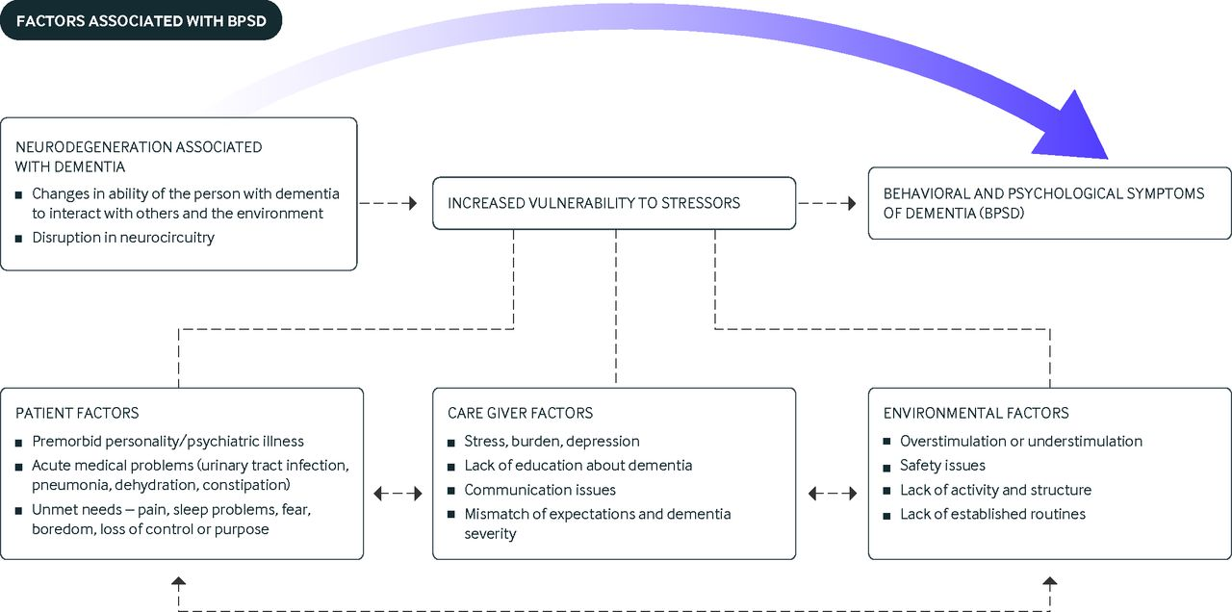
Kales, Gitlin and Lyketsos (2015) Assessment and Management of Behavioural and Psychological Symptoms of Dementia

Slide 9
Who can help (DOPMH) Dementia and Older People’s Mental Health / Not DOPMH
Own home
Care home (RH/NH)
Inpatient
Dementia Adviser
Primary Care Dementia Practitioner (PCDP)
Community Psychiatric Nurse (CPN)
Admiral Nurse
GP team
Voluntary sector
Dementia Liaison Nurse (DLN)
Community Psychiatric Nurse (CPN)
Psychiatric Liaison

Slide 10
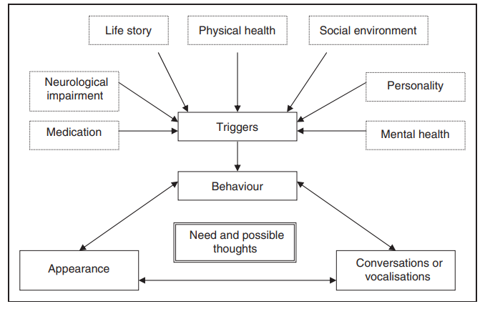
Understanding and identifying an unmet need
James, I, A., (2011) Newcastle Model

Slide 11
James, I, A., and Jackman, L., (2017) The 8 needs framework
Fundamental Need | Features that interfere with someone’s need being met | Expression of someone whose needs are not being met (a wish, demand, request | Is need currently being met? To what extent may it be contributing to behaviour of concern
Physical comfort and freedom from pain | Smell, noise, temp, analgesia, uncomfortable chair, clothes | Verbal, stripping (temp/pain), withdrawn, one word “dirty” = toilet
Perception of Safety
Positive touch
Love and belonging
Esteem needs
Control over environment / possessions (freedom)
Occupation and exploration
Fun

Slide 12
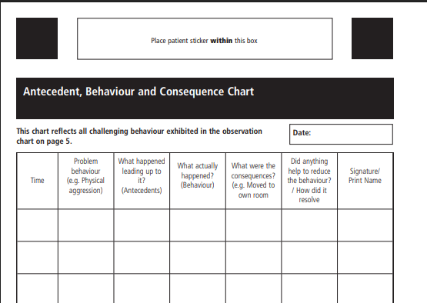
Assessment
DICE
Describe – ABC (Antecedent, Behaviour + Consequence) chart
Investigate – BioPsychoSocial - PLwD, Carer, Environment, utilising Newcastle Model, Functional Analysis – what is reinforcing behaviours
Create – Implement a treatment plan
Evaluate – Is it effective
DISDAT
Distress and Discomfort
Assessment Tool –
Communication impairment

Slide 13
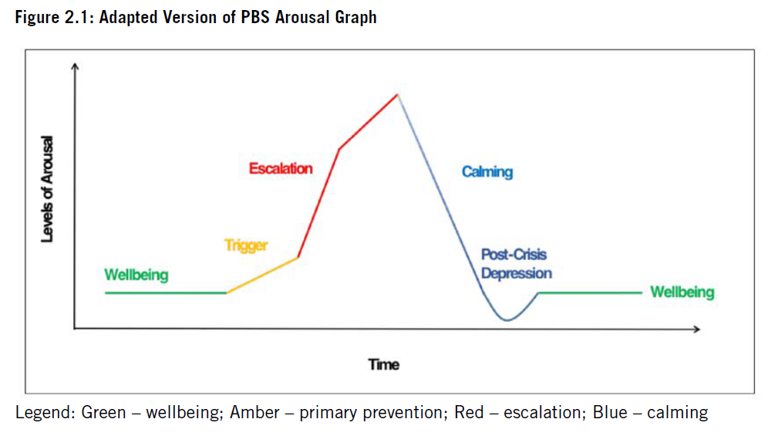
James et al (2024) First Line psychosocial alternatives to psychotropic medication for Behaviours that challenge in dementia care: A toolkit for health and social care practitioners. The British Psychological Society: Leicester

Slide 14
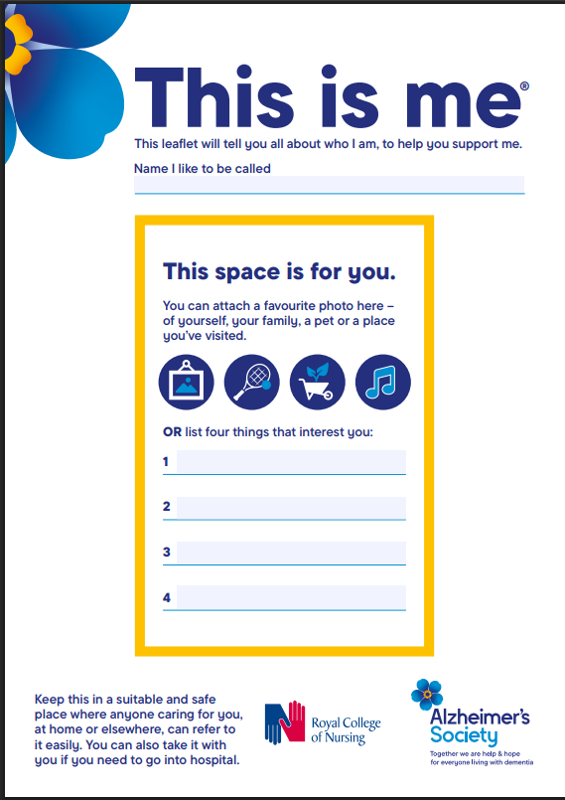
Approaches to maintain Wellbeing
**Carer training to help them understand the purpose of someone’s behaviour Promas https://promas.co.uk/
Personalised care – This is me
Music therapy (particularly if depression identified)
Usually not a single treatment but range
Social interactions
Physical activity
Pleasant (person centred) meaningful activity (gardening, art, DIY)
Sensory focused activities (namaste care) - aromatherapy
Reminiscing
Doll and pet therapy
Environment slide 15
Maintain good physical health

Slide 15
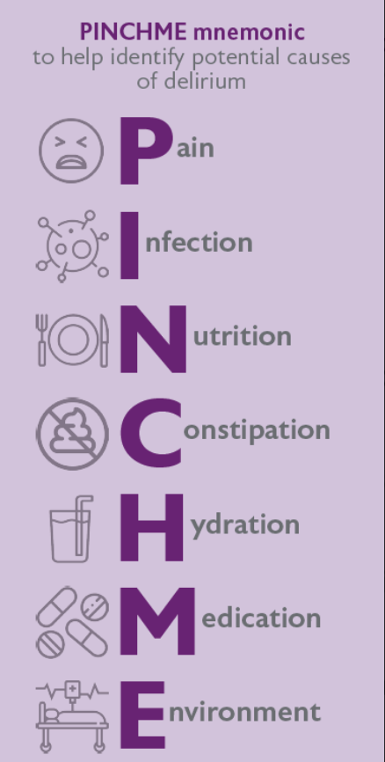
Approaches to de-escalate Triggering
Communication
Eliminate physical causes (think delirium PINCH ME)
Environmental cause elimination
Therapeutic lie
Identify unmet need
Specialist input / crisis services
BANGS
Breathe
Accept
Not argue
Go with flow
Sorry
VERA
Validation
Emotion
Reassure
Activity

Slide 16
Pharm and Non-Pharm approaches Escalation
Least restrictive intervention
Prevention and Management of Violence and Aggression
Local policies
Exit strategies
Pharmacological acute crisis - Benzodiazepines (risk falls, Cognitive Fx)
Delirium 1st line – Olanzapine
2nd line – Lorazepam (Parkinson’s Disease / LBD)
Preventative pharmacology post incident
Calming
Debrief

Slide 17
Tools to help
Pain
Person centred
Abbey pain scale
PAINAD (PAIN in Advanced Dementia)
This is me
Know me book
Good days Bad days
Environment
Behaviour
Kingsfund.. Is your ________ dementia friendly
Alz Soc – Making your home dementia friendly
Home FAST (Falls and Accident Screening Tool)
Antecedent Behaviour and Consequence (ABC) Chart (inpatient)
Challenging Behaviour Scale (RH/NH)
Neuropsychiatric Inventory (NH)

Slide 18
Summary
If you have met one person with dementia, you have met one person with dementia
Useful to know the sub-type of dementia
BPSD / behaviours of concern is not simple get support, specialists across the system
Carer support – Promas

Slide 19
Thank you, any questions?
References
James I, A., (2011) Understanding behaviour in dementia that challenges: a guide to assessment and treatment. London, UK Jessica Kingsley
James, I, A., and Jackman, L., (2017) Understanding behaviour in dementia that challenges: A guide to assessment and treatment. London: Jessica Kingsley
James, I.A., Moniz-Cook, E., Duffy, F., Lord, N., Ritchie, M. & Reichelt, K. (2024). First line psychosocial alternatives to psychotropic medication for Behaviours that challenge in dementia care: A toolkit for health and social care practitioners. The British Psychological Society: Leicester.
Kales H C, Gitlin L N, Lyketsos C G. Assessment and management of behavioral and psychological symptoms of dementia BMJ 2015; 350 :h369 doi:10.1136/bmj.h369 available at Assessment and management of behavioral and psychological symptoms of dementia | The BMJ access on 07/04/2025.
NHS Digital (2025) Primary Care Dementia Data, available at https://digital.nhs.uk/data-and-information/publications/statistical/primary-care-dementia-data/february-2025 accessed on 31/03/25

